Slide 1

COLLEGE NETWORK
A Synopsis Submitted
in Partial Fulfillment of the
Requirements for the Degree of
BACHELOR OF TECHNOLOGY
in
COMPUTER SCIENCE AND ENGINEERING
by
Vivek Kumar Suvam (1901500100113)
Under the Supervision of
Mr. Sunny Savita
DEPARTMENT OF COMPUTER SCIENCE AND ENGINEERING
CET-IILM-AHL, GREATER NOIDA
Dr. A.P.J. ABDUL KALAM TECHNIAL UNIVERSITY, LUCKNOW
2022-2023

Slide 2
Objective and scope of the project
The main objective of the proposed network is to update the existing network of the campus.
So the scope of the project is that enhance its capabilities and increase the flexibility of the network which will eventually provide good security.

Slide 3
Methodology
Make a layout of the area where to establish a network.
Select the devices according to the need in the premises.
Specific area should have its own main router.
Each main router should be connected with each other by routing protocols.
Then provide IP address to the network and subnet according to their users in the premises.

Slide 4
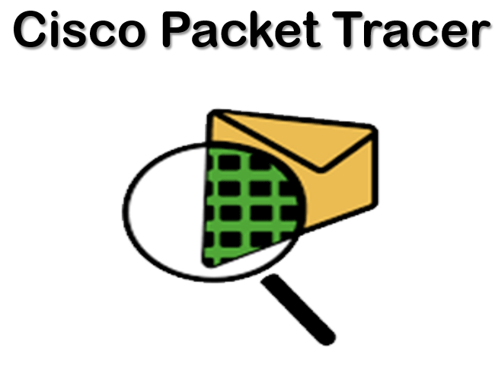
Software Used
Cisco Packet Tracer
Packet Tracer is a cross-platform visual simulation tool designed by Cisco Systems that allows users to create network topologies and imitate modern computer networks. The software allows users to simulate the configuration of Cisco routers and switches using a simulated command line interface

Slide 5
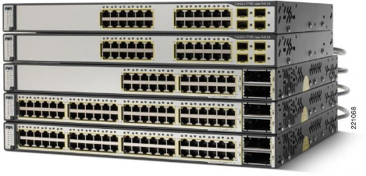
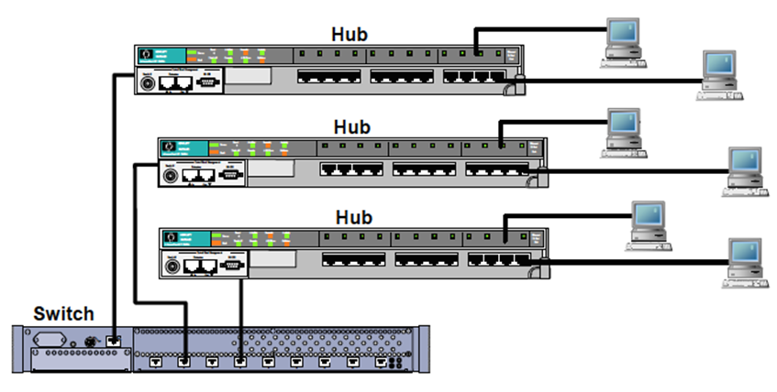
Tools and Technology
Routers
A router receives and sends data on computer networks. Routers are sometimes confused with network hubs, modems, or network switches. However, routers can combine the functions of these components, and connect with these devices, to improve Internet access or help create business networks.
Hubs & Switches
A network hub is a central connection point for devices in a local area network, or LAN. But there's a limit to the amount of bandwidth users can share on a hub-based network. The more devices are added to the network hub, the longer it takes data to reach its destination. A switch avoids these and other limitations of network hub.

Slide 6
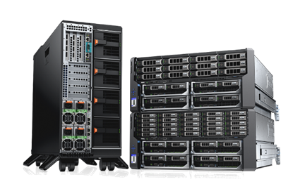
Servers
A server is a piece of computer hardware or software (computer program) that provides functionality for other programs or devices, called "clients". This architecture is called the client–server model. Servers can provide various functionalities, often called "services", such as sharing data or resources among multiple clients, or performing computation for a client. A single server can serve multiple clients, and a single client can use multiple servers. A client process may run on the same device or may connect over a network to a server on a different device. Typical servers are database servers, file servers, mail servers, print servers, web servers, game servers, and application servers.

Slide 7
Limitations
Not user friendly
Optimization is difficult to achieve
High cost and maintenance intensive

Slide 8
Future Scope
The new system should be able to reduce internet downtime. Download and upload links should be maintained above 500 Mbps speed requirement.
Network will be scalable.
The system should support remote access.
Should comprise of data centers with necessary security features and support.

Slide 9
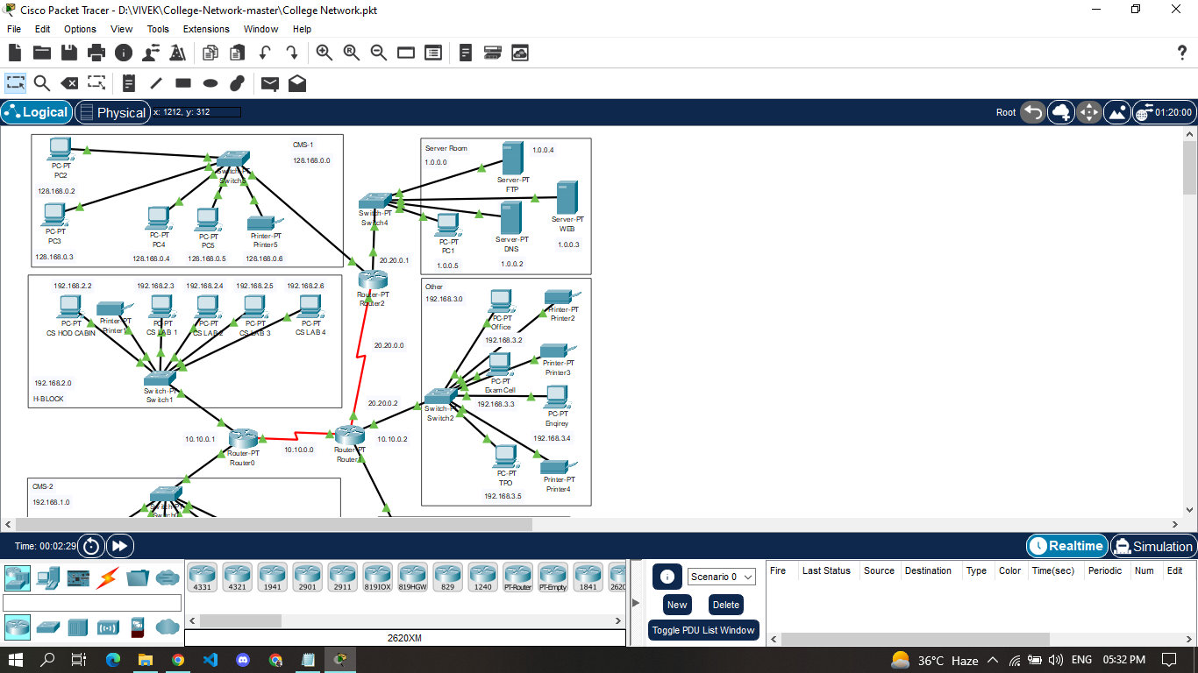
Conclusion
The outcome of the proposed system will be a fail-safe backbone network infrastructure which meets the requirements for readily available access to information and security of the private network, and also ensures optimized productivity when telecommunication services are accessed. The installed equipment allowed to organize high-speed wired and wireless Internet access throughout the whole complex of hospital buildings as well as providing transfer of all types of data throughout the single optimized network.

Slide 10
References
https://www.netacad.com
https://www.youtube.com/c/NetworkkingsOrgtraining
https://www.emetechnologies.com

Slide 11
THANK YOU

